Slide 1

Unreal Engine 5
Introduction Workshop.

Slide 2


What is Unreal Engine 5?
Unreal Engine 5 is a 3D game engine developed by Epic Games.
The term 'game engine' refers to a software that is used to develop virtual experiences.
Unreal Engine 5 is utilised across several industries including game development, architectural visualisation and immersive installations.

Slide 3


Slide 4
Workshop Overview
UE5 Interface
Quixel Bridge
Actors
Interactivity

Slide 5

Unreal Engine 5
User Interface

Slide 6
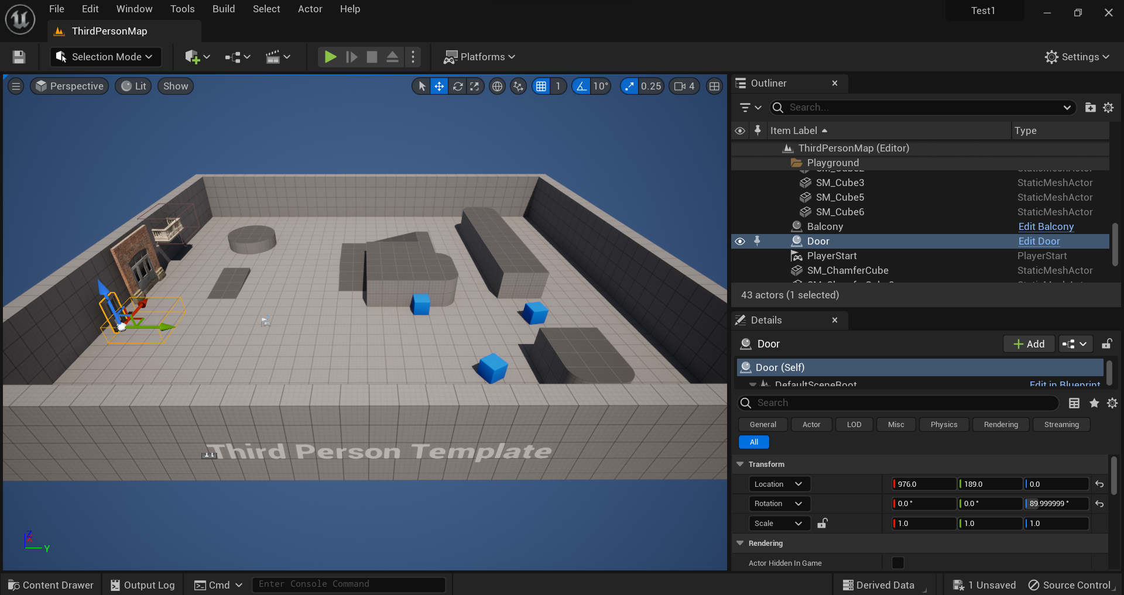

Slide 7
Menu Bar

Slide 8
Toolbar
Notes:
Save, Mode Selection, Content Shortcut, Play Mode, Platform Menu, Settings

Slide 9
Viewport

Slide 10
Content Drawer

Slide 11
Output Log & Cmd
Notes:
Output Log, Command Console, Derived Data, Source Control Status

Slide 12
Outliner

Slide 13
Details

Slide 14
Unreal Engine 5
Quixel Bridge

Slide 15
What is Quixel Bridge?
A plugin that comes installed in the editor.
Browse collections and search for specific assets.
1
3
2
Access the Megascans library - the largest and fastest growing 3D scan library.
4
Add assets to your Unreal Engine projects.

Slide 16
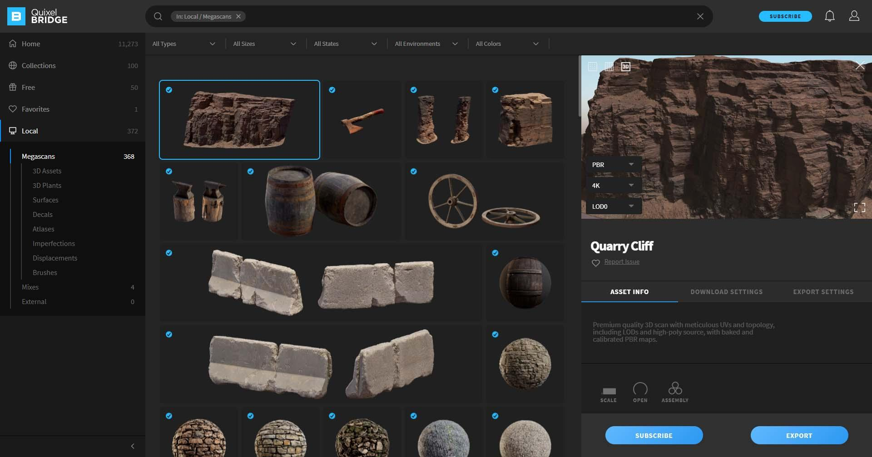

Slide 17
Folders

Slide 18
Assets

Slide 19
Chosen Asset

Slide 20
Download

Slide 21
Unreal Engine 5
Actors

Slide 22
What is an actor?
Any object that can be placed into a level.
Actors support 3D transformations such as translation, rotation, and scaling.
1
3
2
Such as a Camera, static mesh, or player start location.
4
They can be created (spawned) and destroyed through gameplay code.

Slide 23
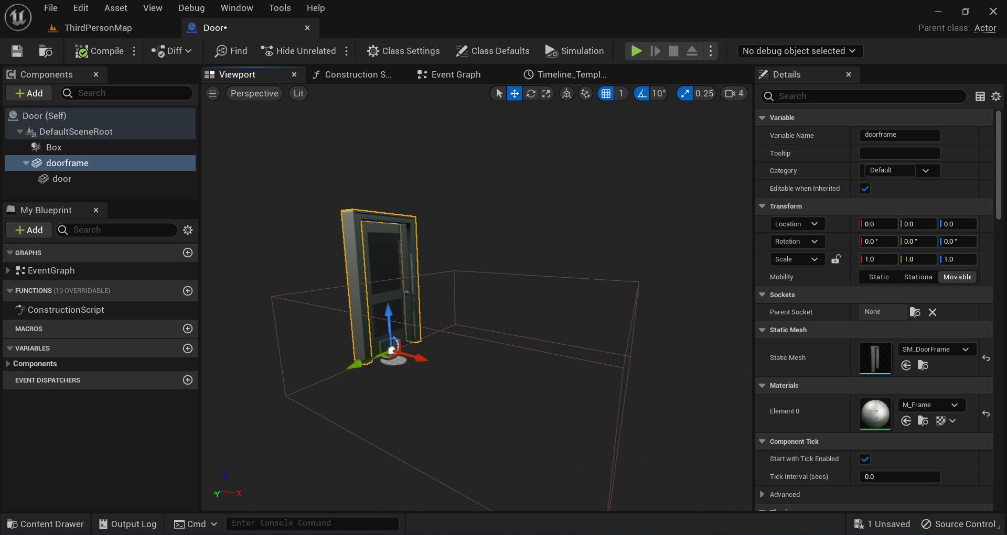

Slide 24
Components

Slide 25
My Blueprint

Slide 26
Toolbar

Slide 27
Viewport

Slide 28
Details

Slide 29
Unreal Engine 5
Interactivity

Slide 30
What is Blueprint?
Visual scripting language in Unreal Engine 5.
Use blueprint to program events and interactivity.
1
3
2
Node-based interface to create gameplay elements from within Unreal Editor.
4
Easy to learn for people without a coding background.

Slide 31
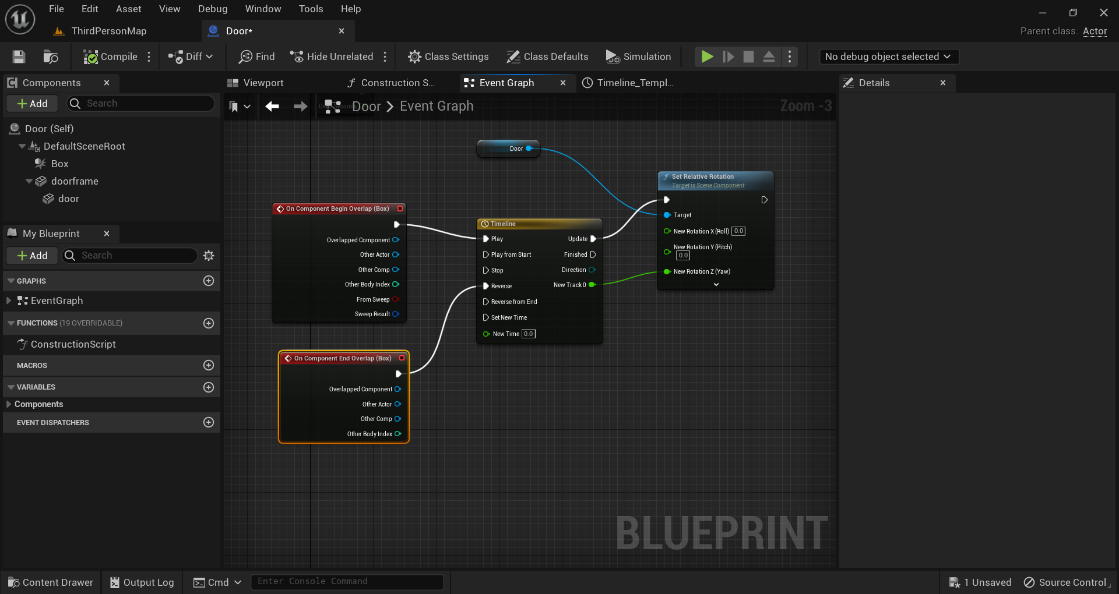

Slide 32
Event Graph

Slide 33
Event Nodes

Slide 34
Blueprint Nodes

Slide 35
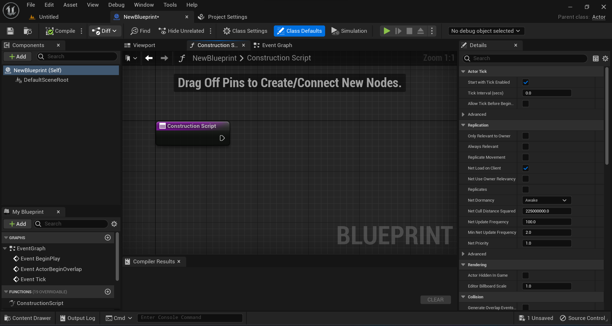
Construction Script

Slide 36
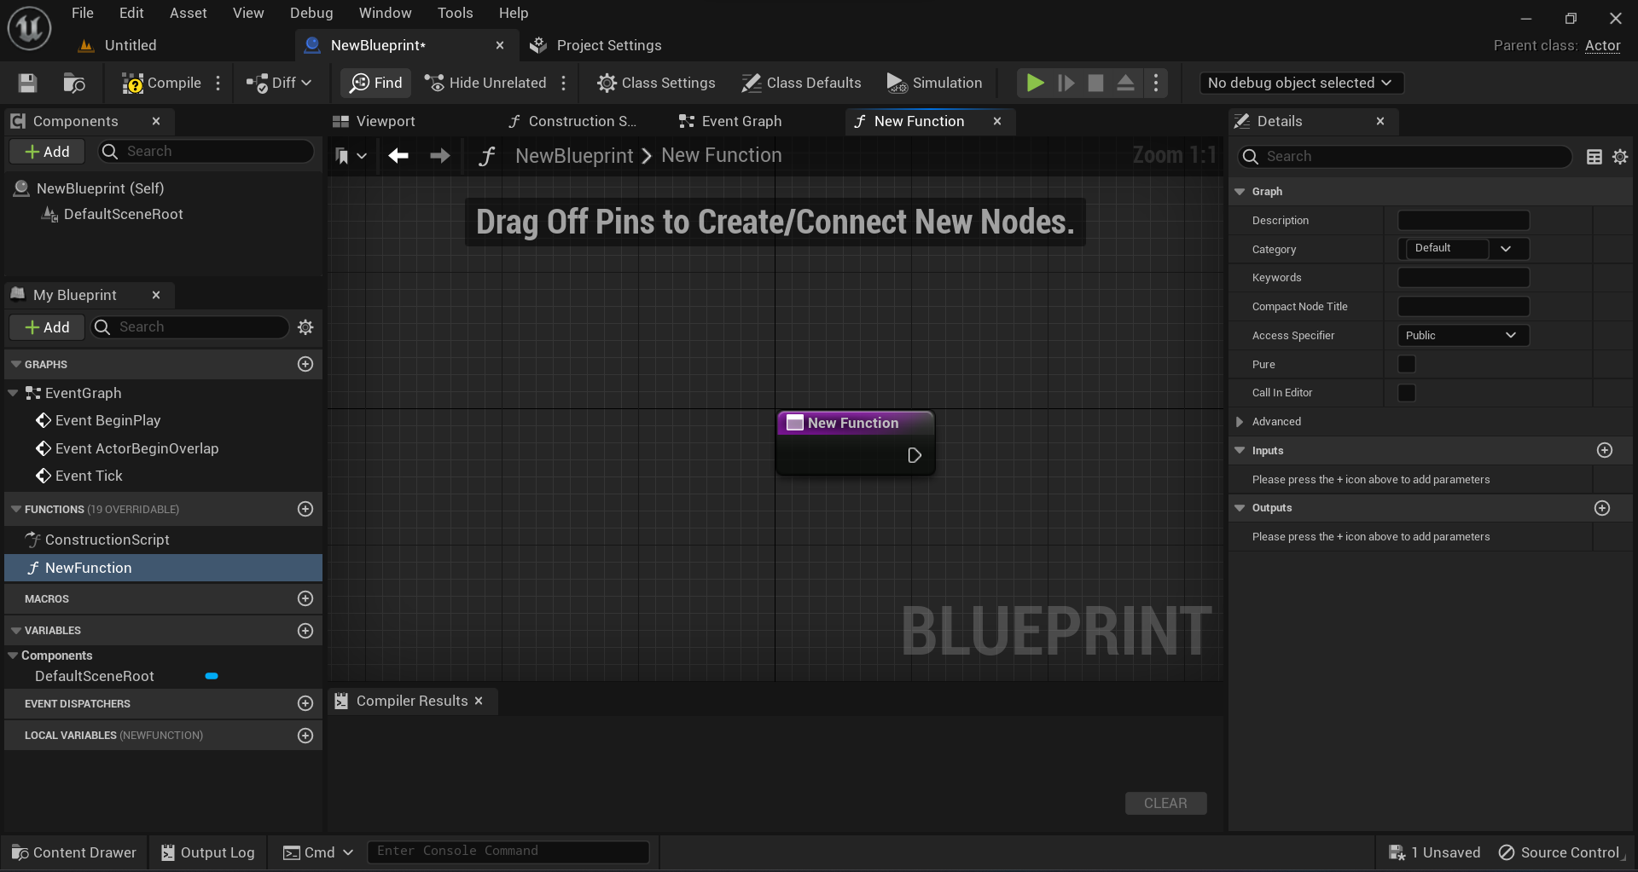
Functions

Slide 37
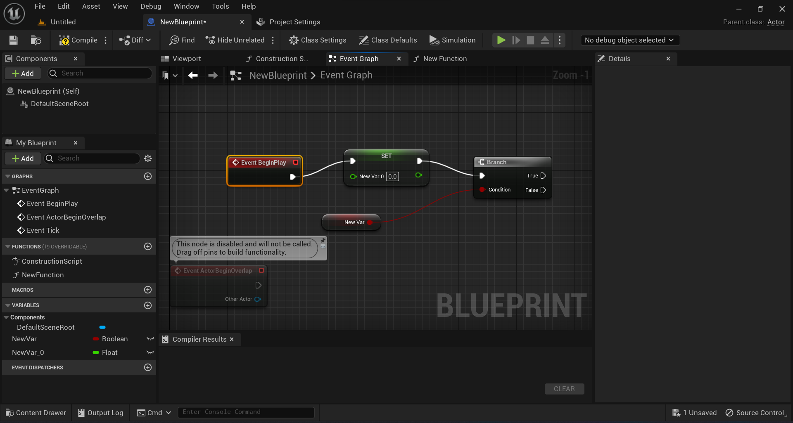
Variables

Slide 38
Unreal Engine 5
Introduction Workshop.
rian.stephens@rca.ac.uk
Consultations on Moodle - Rian Stephens

